Slide 1
Drawing for Seeing and Understanding: The Human Form
Marilyn Russell, Director of Education, Carnegie Museum of Art
Lisa Barsom, PhD, Assistant Vice Chancellor for Academic Affairs,
University of Pittsburgh School of Medicine
Life Drawing instructor: Paul O’Brien, Programs Coordinator,
The Andy Warhol Museum
Pittsburgh, Pennsylvania

Slide 2
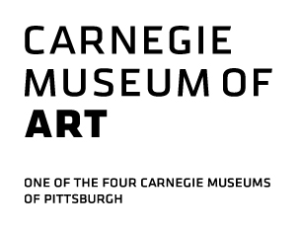
Looking for Seeing and Understanding
4-session, non-credit mini-elective; students earn a certificate of completion, recognized on student transcript
open to first and second year Pitt medical students; course capacity is 15 students
curriculum includes discussion and drawing from works of art and the undraped model in the galleries and studio at Carnegie Museum of Art

Slide 3
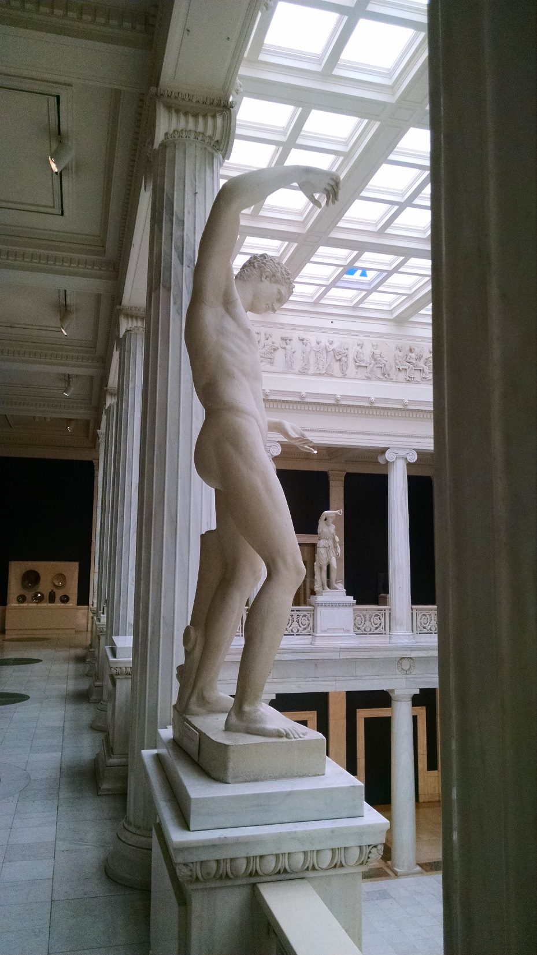
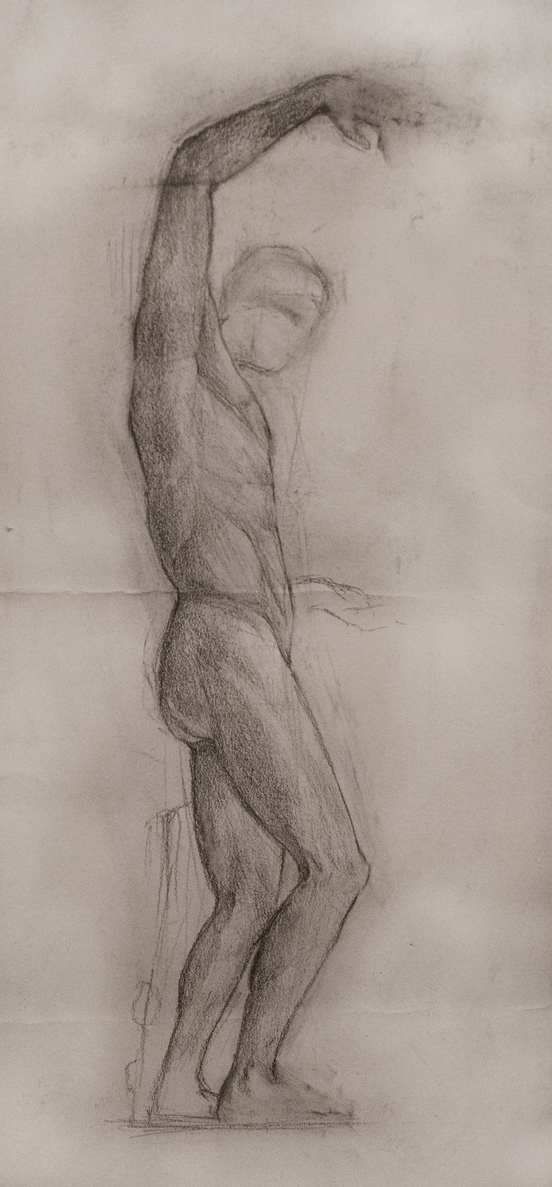

Slide 4
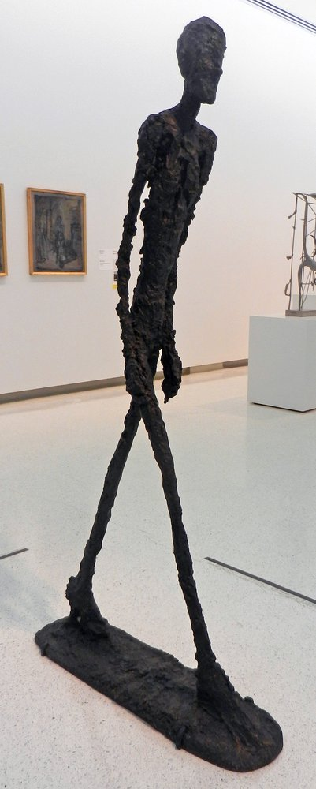
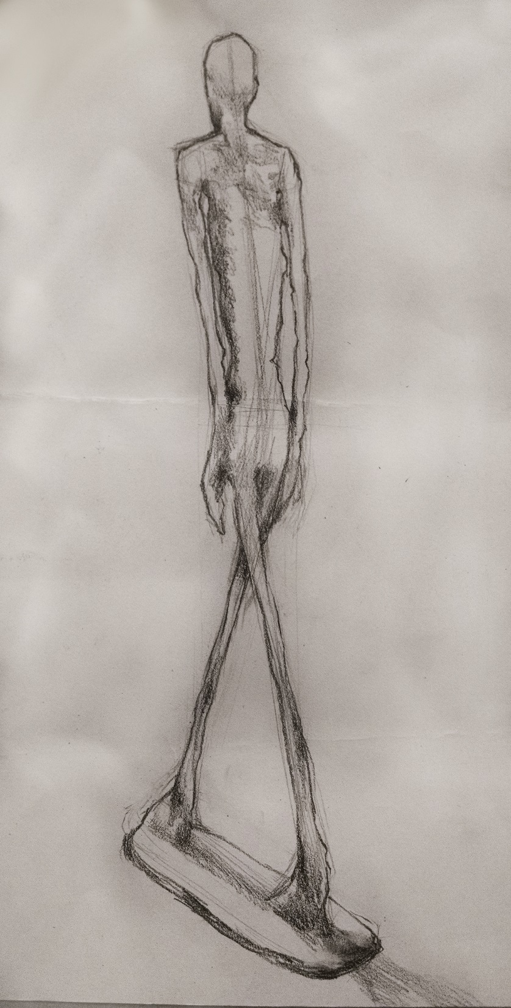
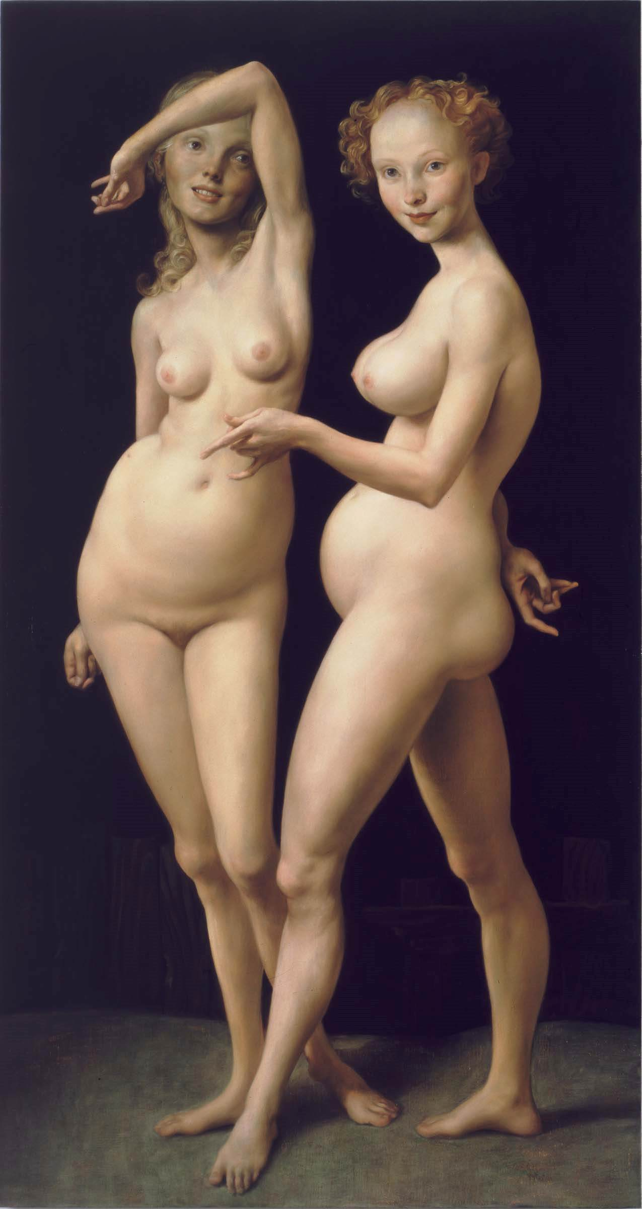

Slide 5
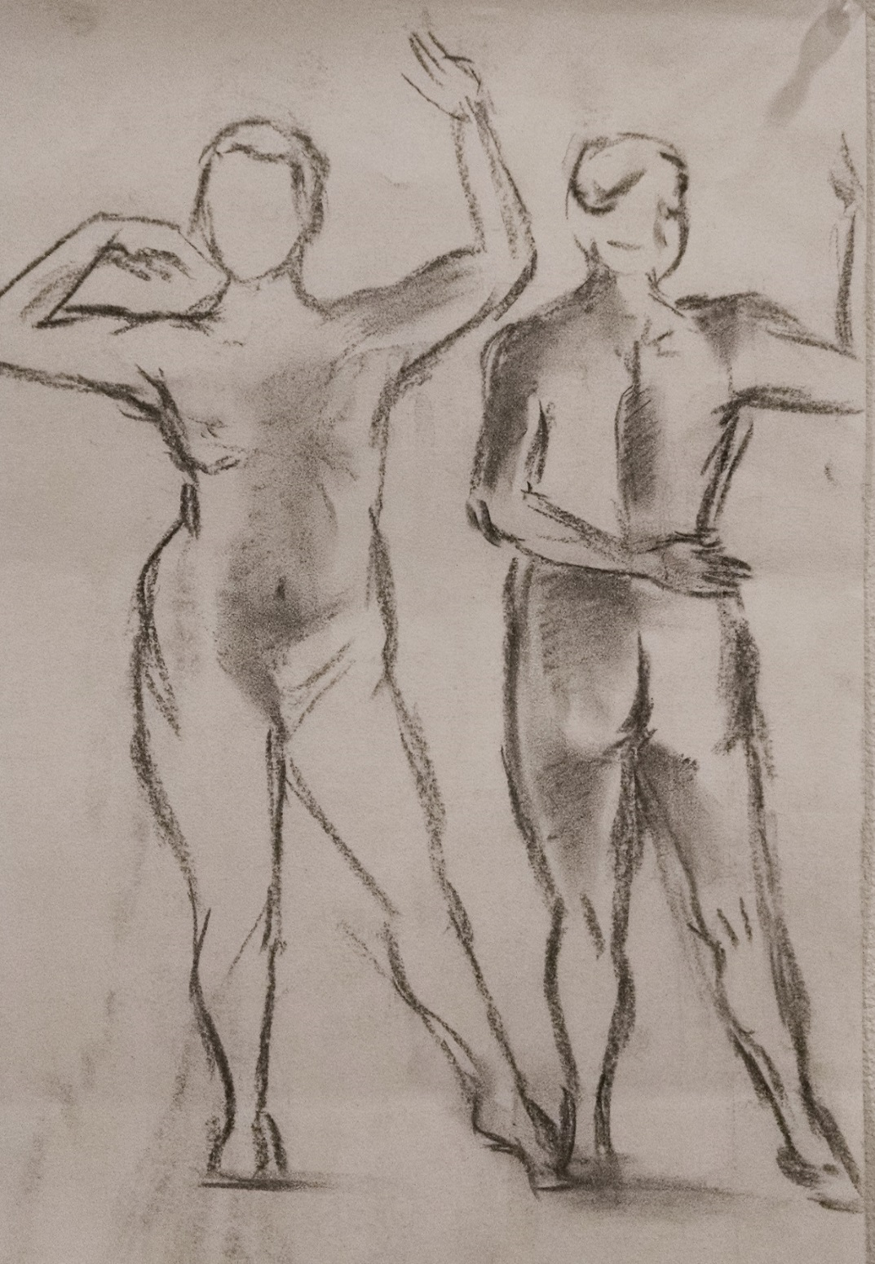
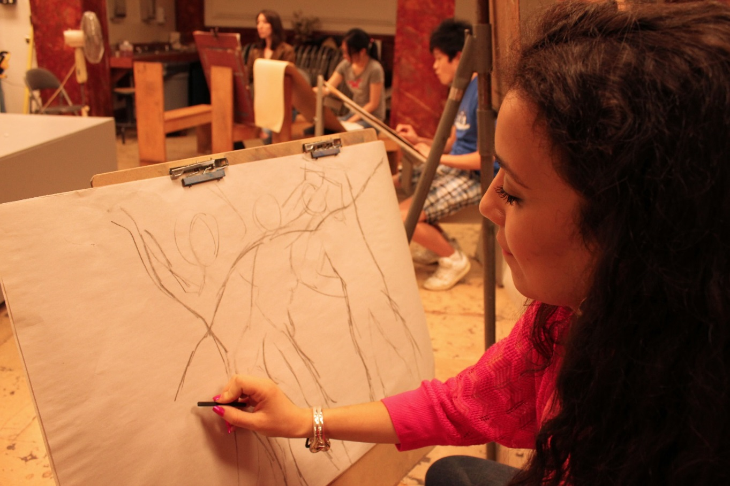

Slide 6
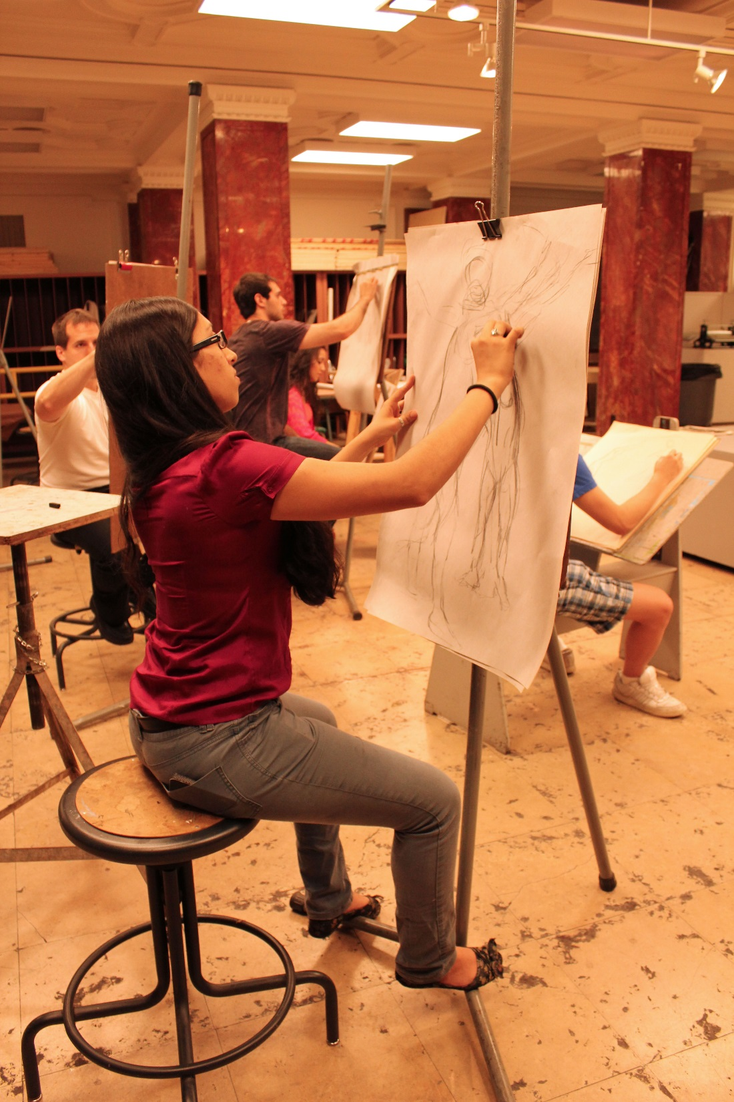
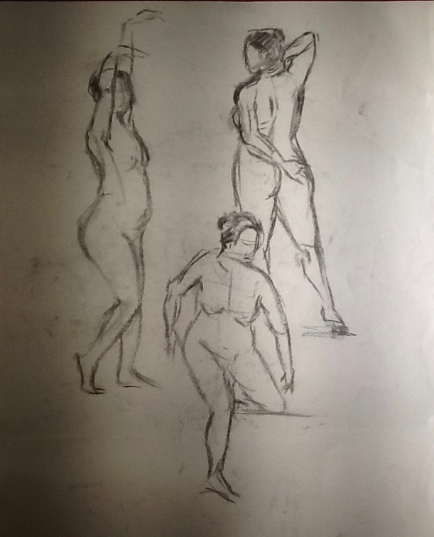

Slide 7
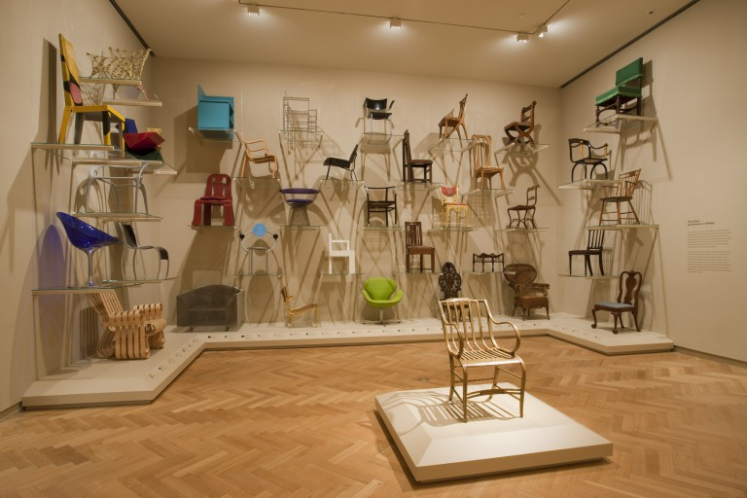
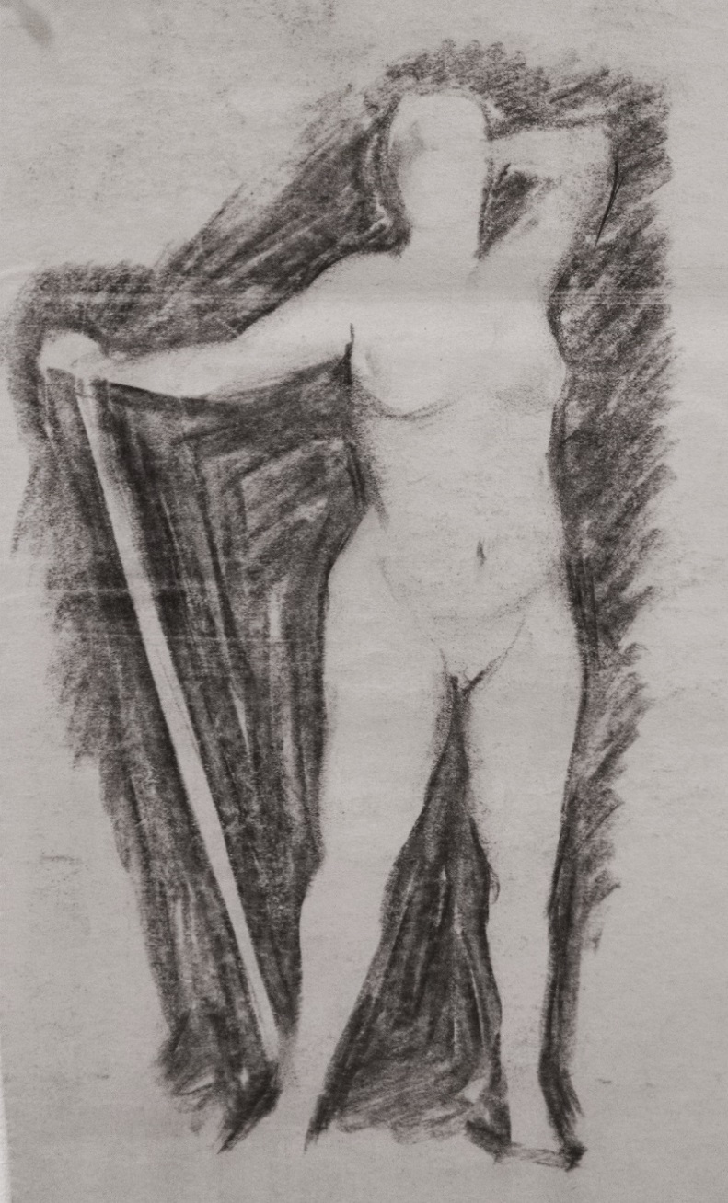
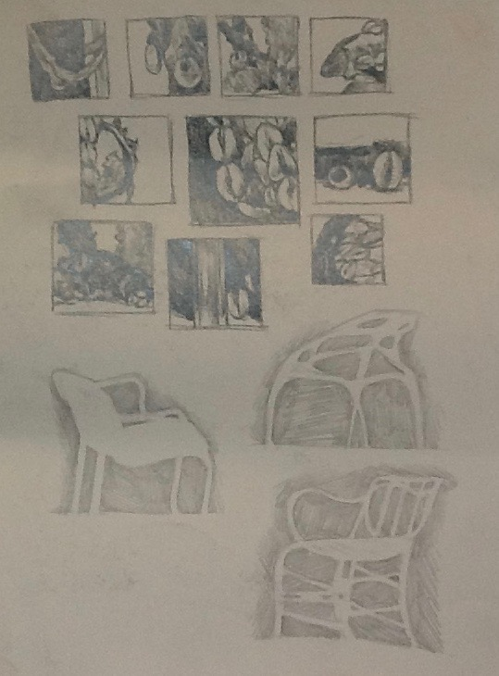

Slide 8
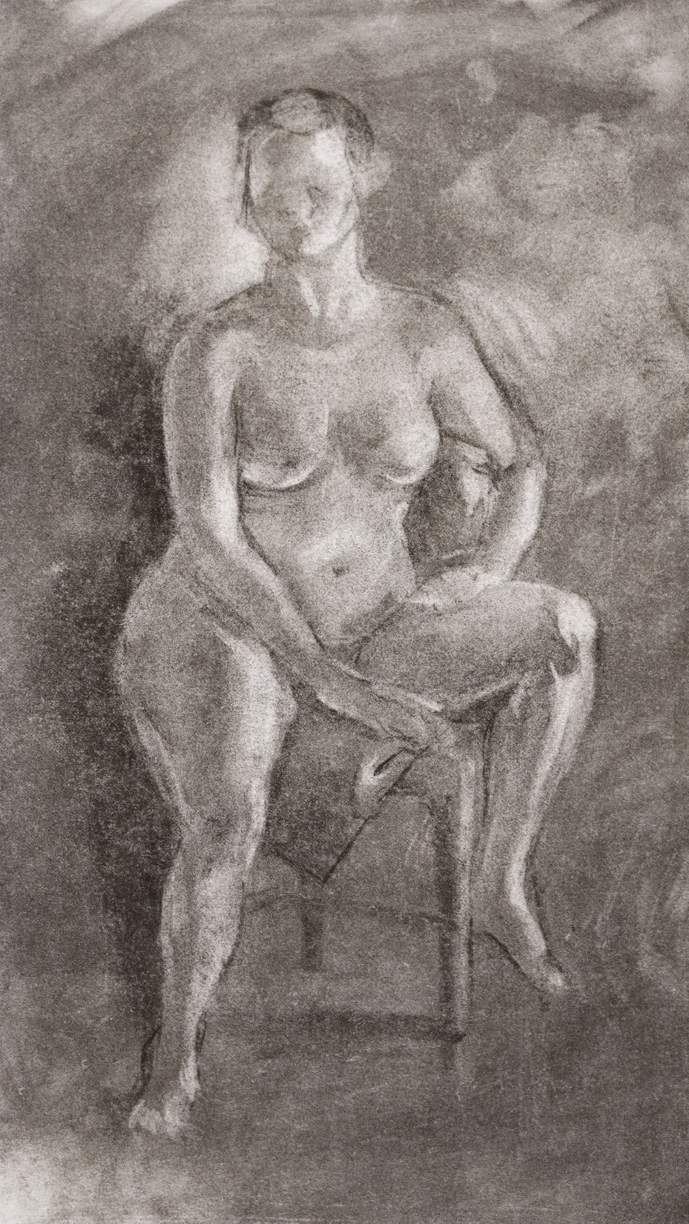

Slide 9
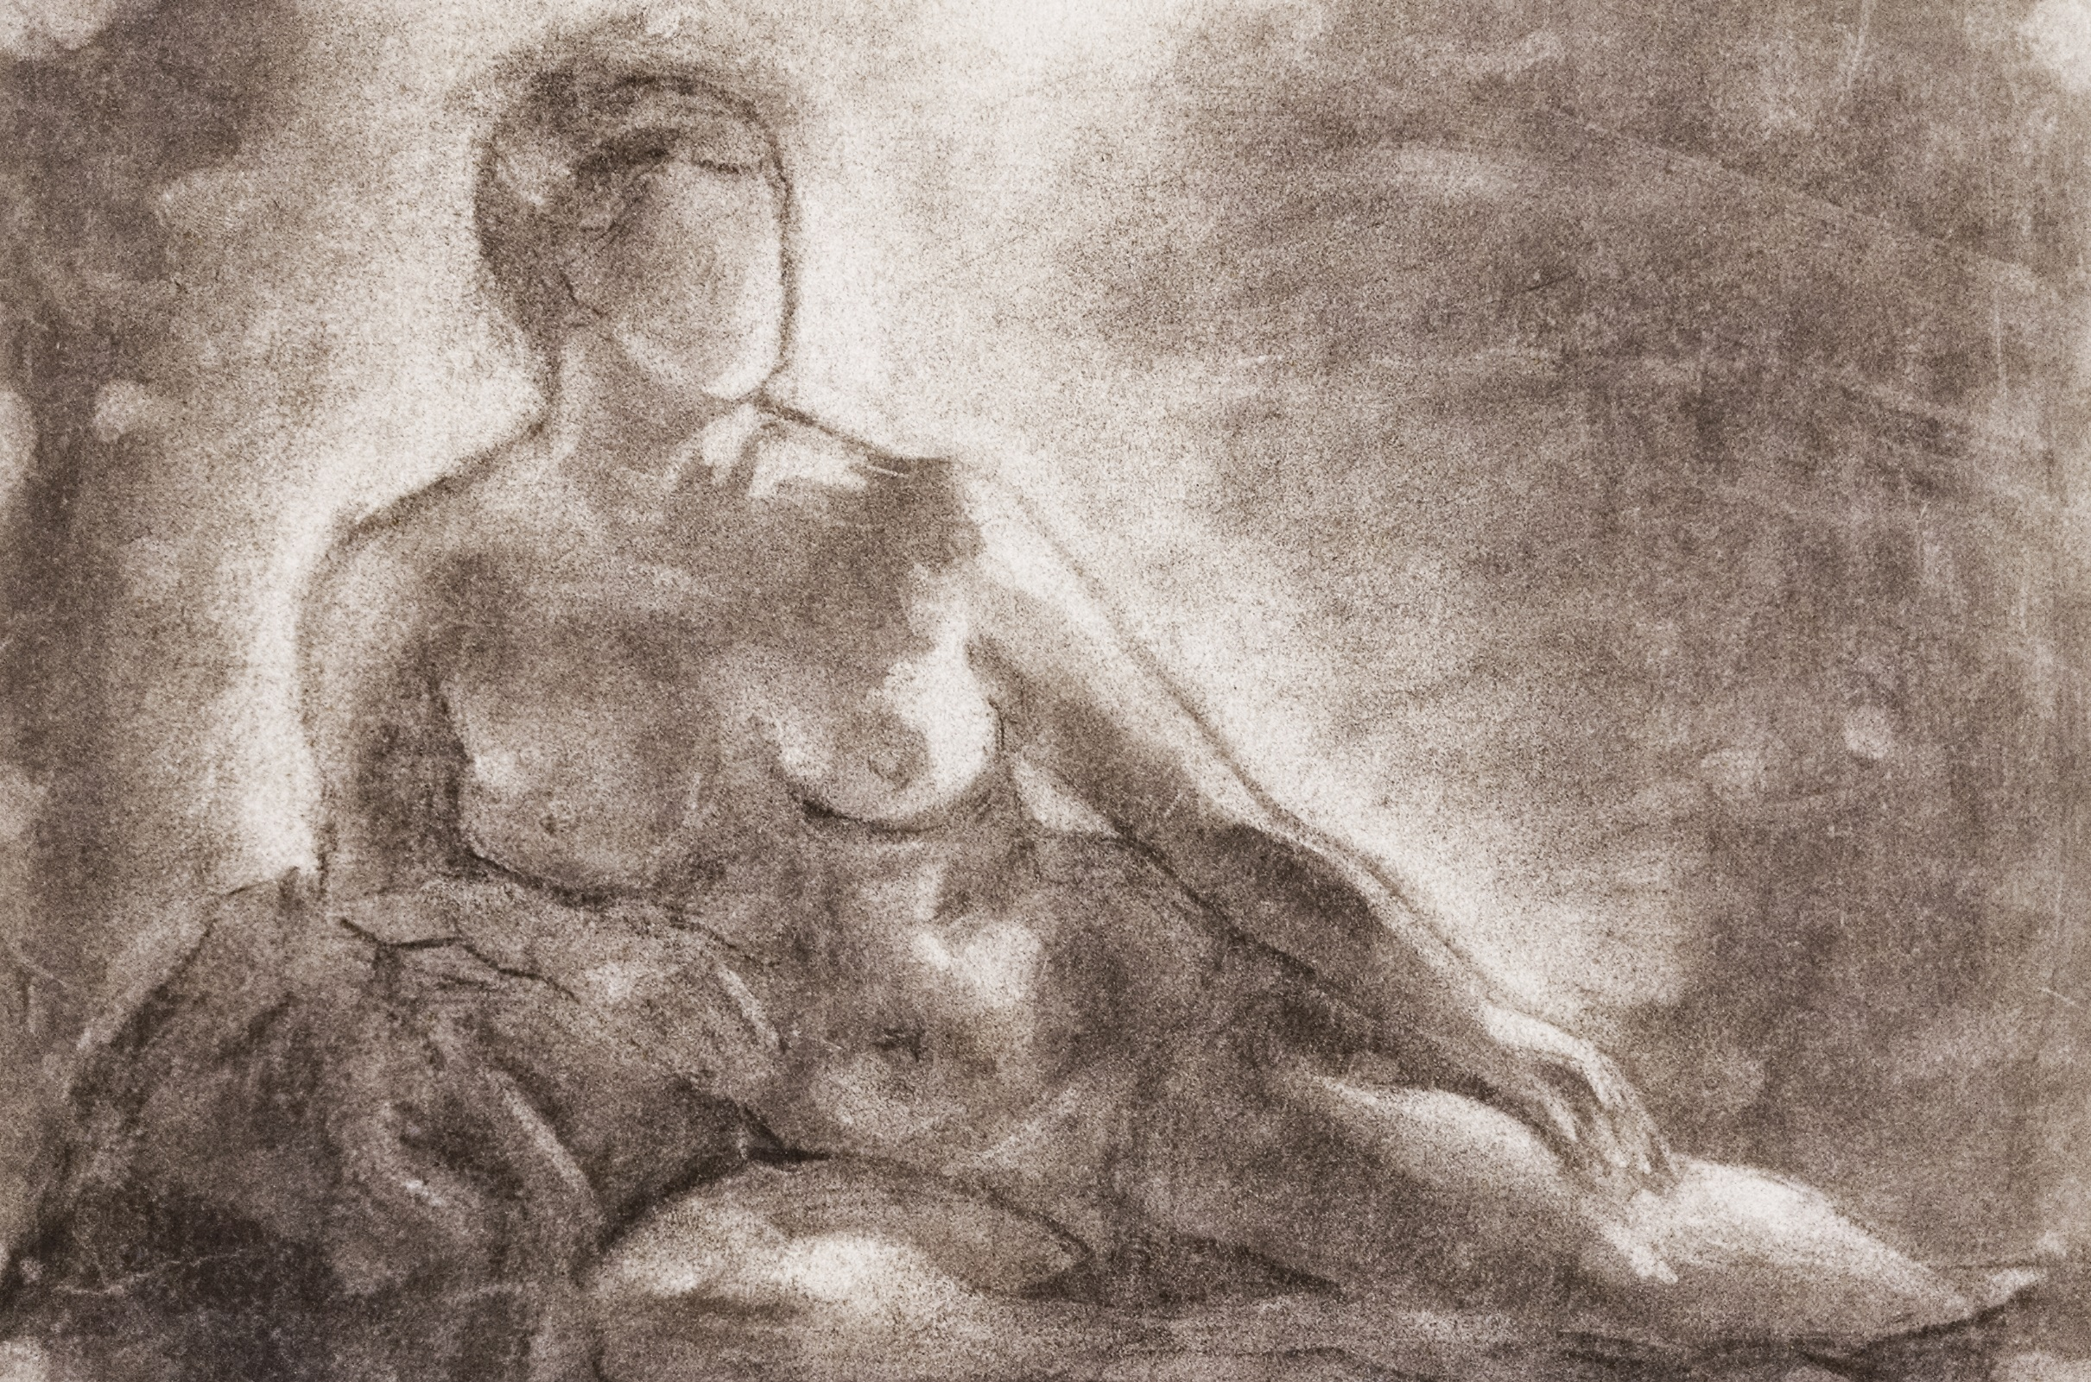

Slide 11
Harnessing the power of art to improve health outcomes
Hope Torrents & Dr. Valerie Bell

Slide 12
FAOHC objectives
Interdisciplinary group n=50
-medical students (Interns)
-nursing students
(under grad & grad)
-physical therapy students
(1st & 2nd yr)
-psychology students (grad)
Address cultural diversity in Miami
Participants attend 3 sessions a year
Provide interdisciplinary platform to improve critical thinking, visual literacy, & communication skills
Provide an overview for methodology used to link art to health care
Creating art: students as artists
Notes:
Facilitate a short discussion

Slide 13
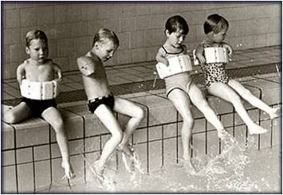
Aesthetic Skills in the Clinic
Description
Flexible thinking
Tolerance of uncertainty/navigation of ambiguity
Teamwork
Listening
Observation (inspection)

Slide 14
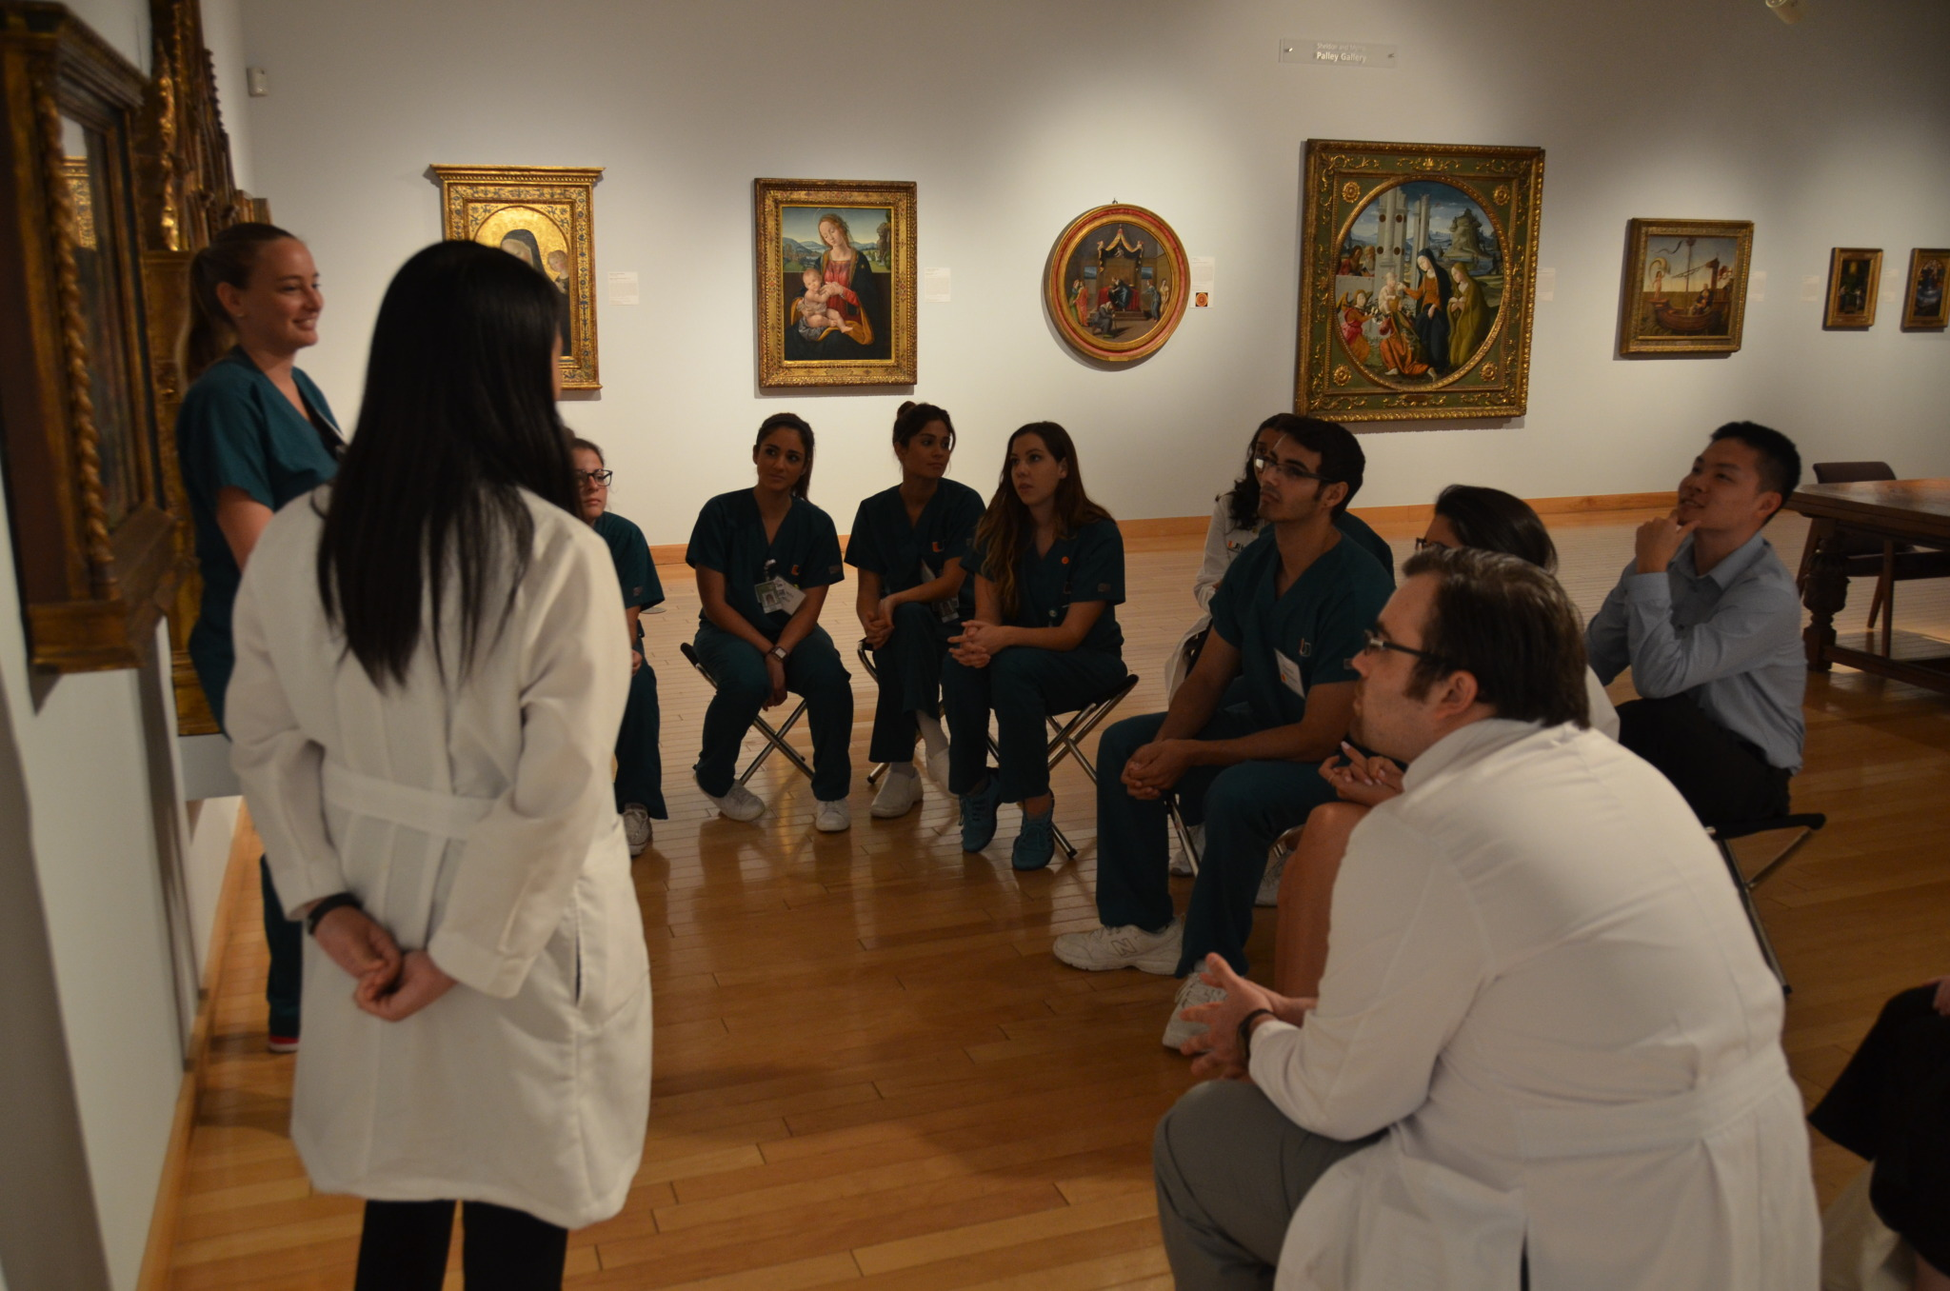
Unique to the FAOHC Program
Interdisciplinary
Students as facilitators & co-facilitators
Neutrality
Leadership skills
Paraphrasing
Non-directed discussions
Reflect on Evidence Based Practice (EBP)
Develop student’s artistry

Slide 15
FAOHC Student Artists
Sketch:
Negative/positive space
Communication: students look and sketch
Connections to clinical skills:
See what we know. Don’t see what we don’t know.
Students practice communication and listening skills to create drawings based on descriptions.

Slide 16
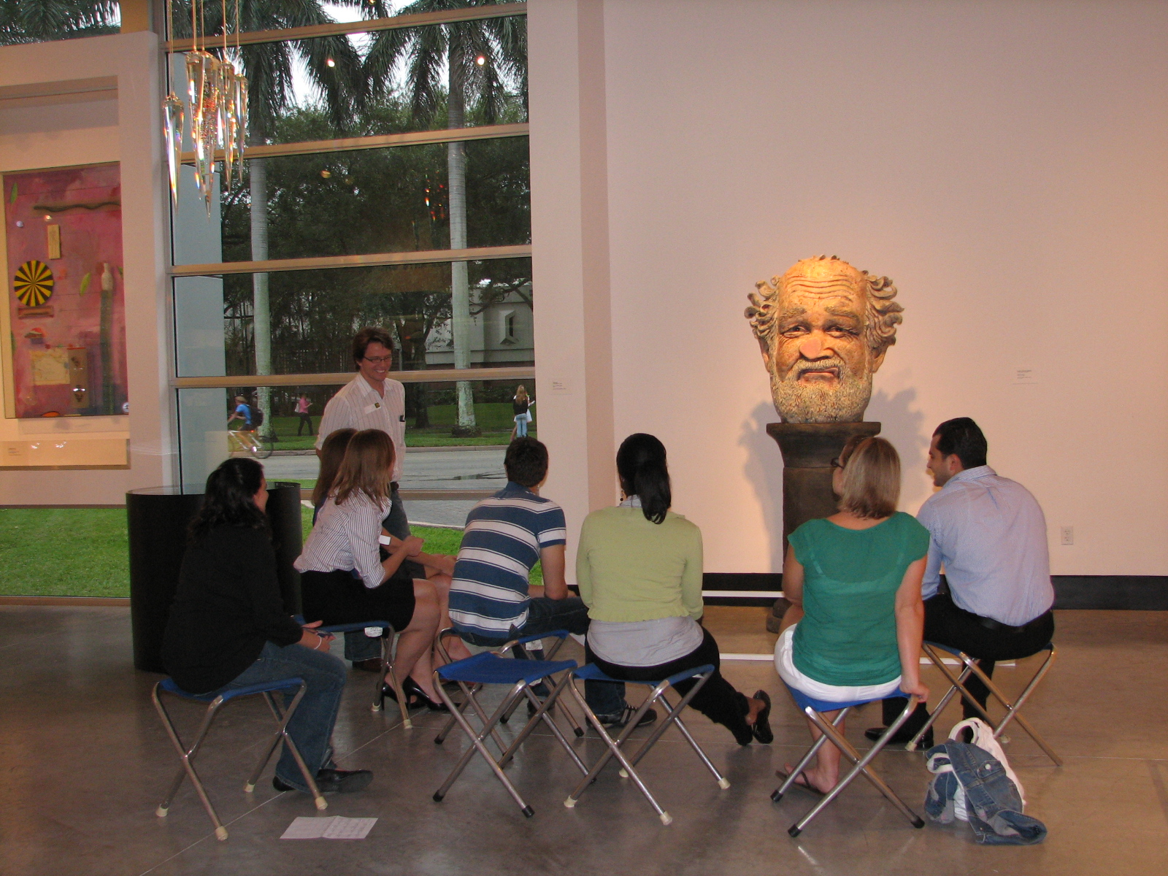
Collaboration
Working together to answer open-ended questions aids all students with communication, sharing and debiasing and prevents anchoring.
Fosters increased respect for divergent opinions, opens eyes and minds to details. (looking and creating)

Slide 17
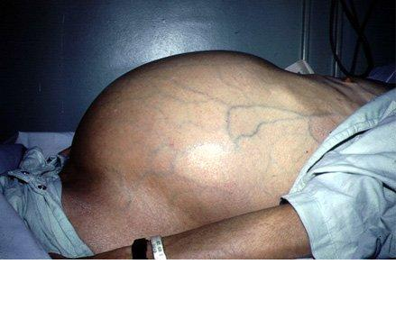
Clinical Picture & Experiential Knowledge
Views, thoughts, observations in the field
How we integrated VTS in Anesthesia curriculum
Parallels with debriefing in simulation
Student reaction
involvement/feed-back

Slide 18
Contact Information
Hope Torrents, Lowe Art Museum, University of Miami,
htorrents@miami.edu , blog: fineartofhealthcare.com
Dr. Valerie Bell, University of Miami Hospital
v.bell@miami.edu

Slide 20
Art Making in Observation and Uncertainty in Art and Medicine
Columbia University Medical Center
Weill Cornell Medical College
The Metropolitan Museum of Art
ArtMed inSight
Presenter: Anna Willieme, MFA
The Metropolitan Museum of Art and ArtMed inSight

Slide 21
Observation and Uncertainty in Art and Medicine
Medical Institutions: Columbia University Medical Center and Weill Cornell Medical College
Offered to 12 1st year medical students, 6 from Columbia and 6 from Cornell
Six 2-hour sessions over a period of 6 weeks
Goals: strengthen observation; further emotional awareness; support meta-cognition; enhance creative thinking
Currently the subject of a study conducted by Columbia and Cornell
Program Directors:
Edie Langner, MD: Director Art and Medicine Project, Program in Narrative Medicine, Columbia University Medical Center
Rachel Dubroff, MD: Director of the Art/Medicine Program, Weill Cornell Medical College
Course Design and teaching:
Anna Willieme, MFA, Founder and Director of ArtMed inSight
In collaboration with The Metropolitan Museum of Art

Slide 22
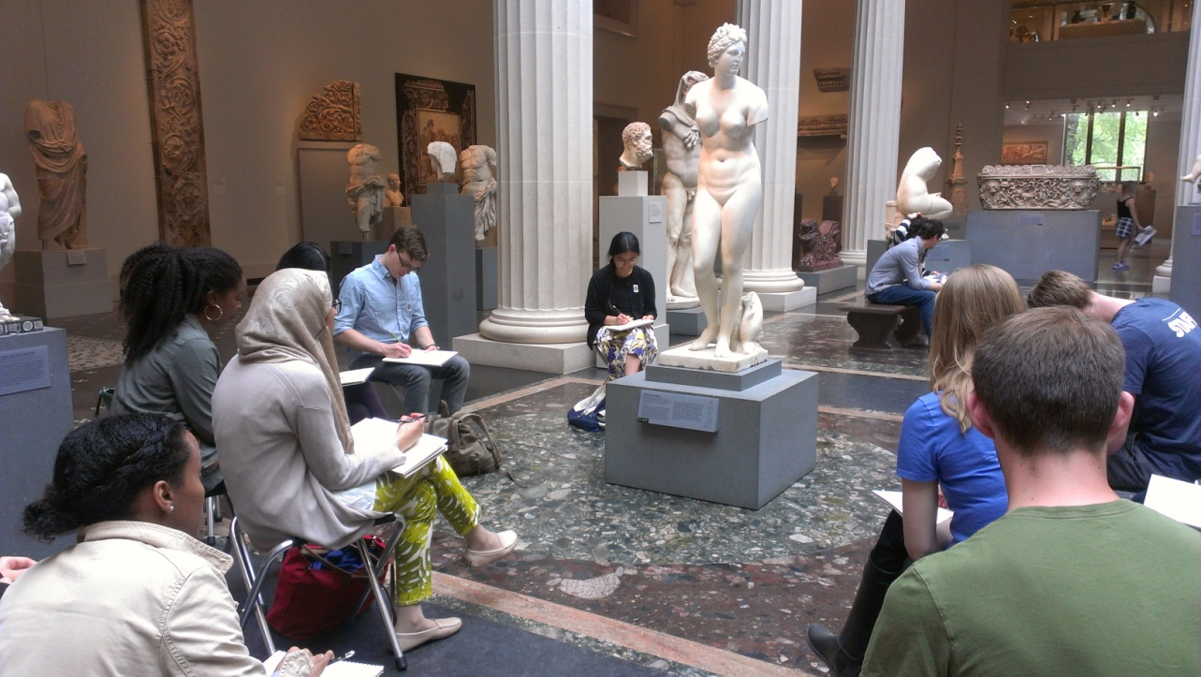
Art making can support:
Observational Skills
Presence
Exploration of Point of View
Emotional Awareness
Creative Thinking
Stress Release

Slide 23
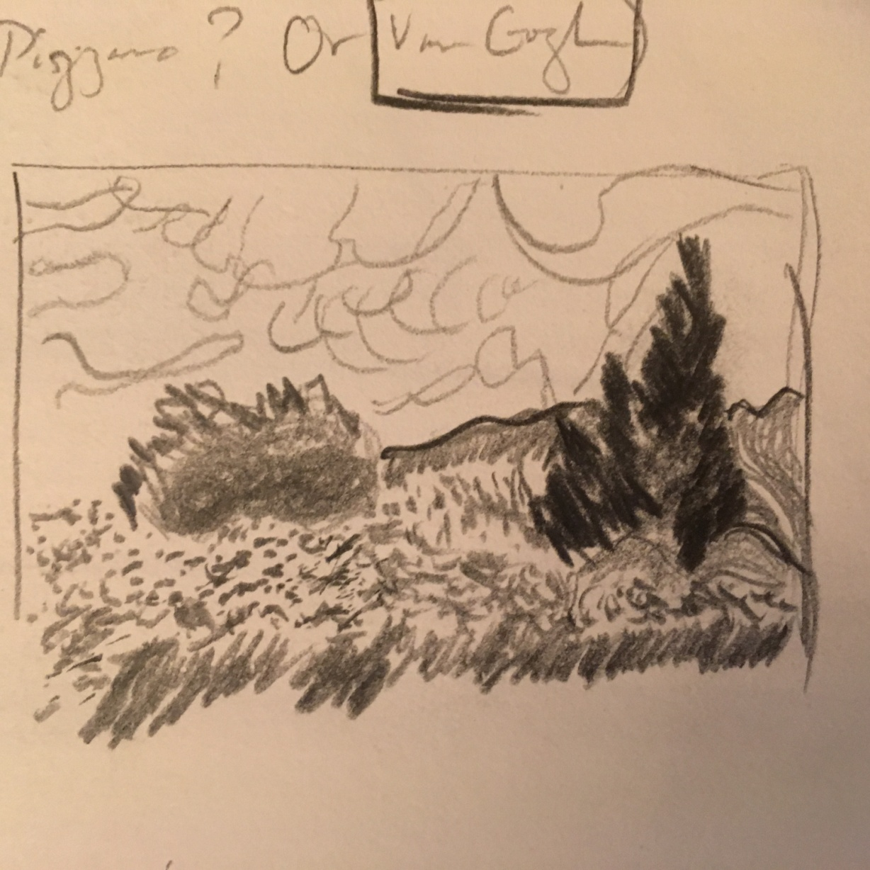
Sketch from Van Gogh’s Wheat Field with Cypress Trees
Eric Zheng

Slide 24
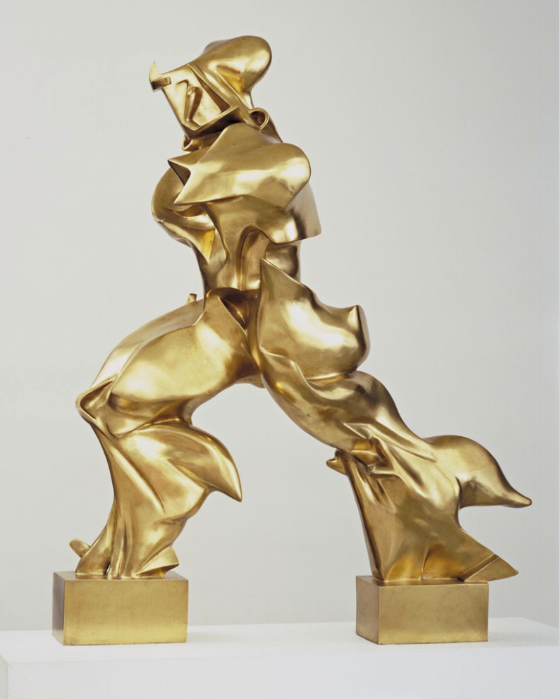
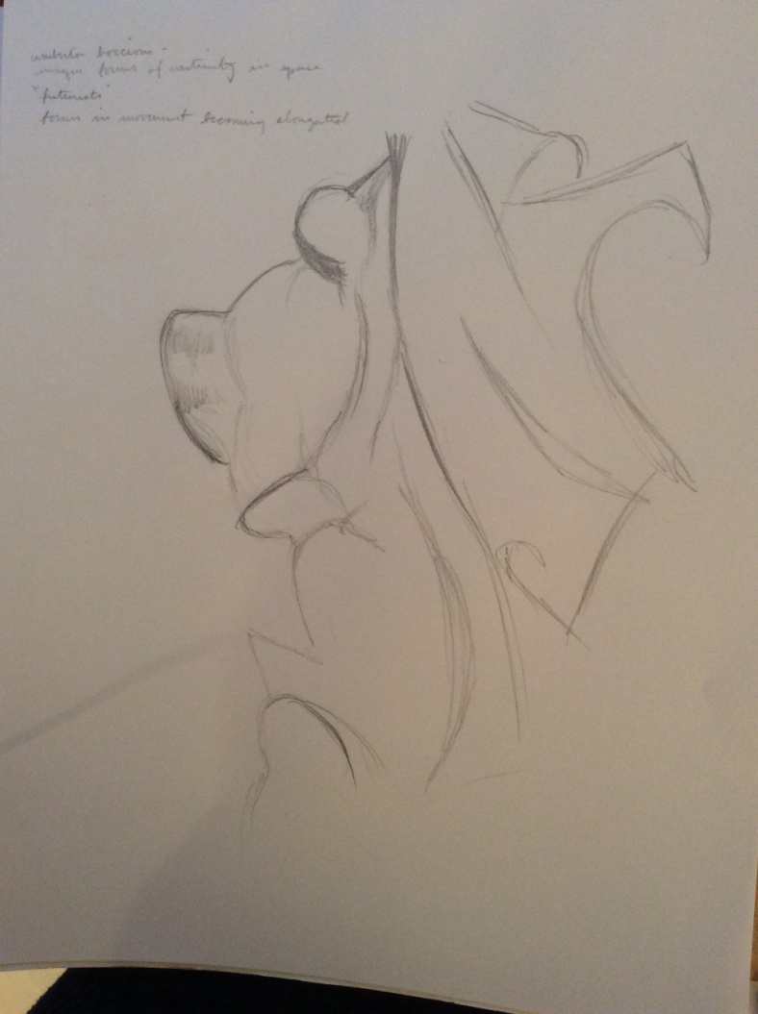
Sketch from Boccioni’s Unique Forms of Continuity in Space
Natalie Diacovo

Slide 25
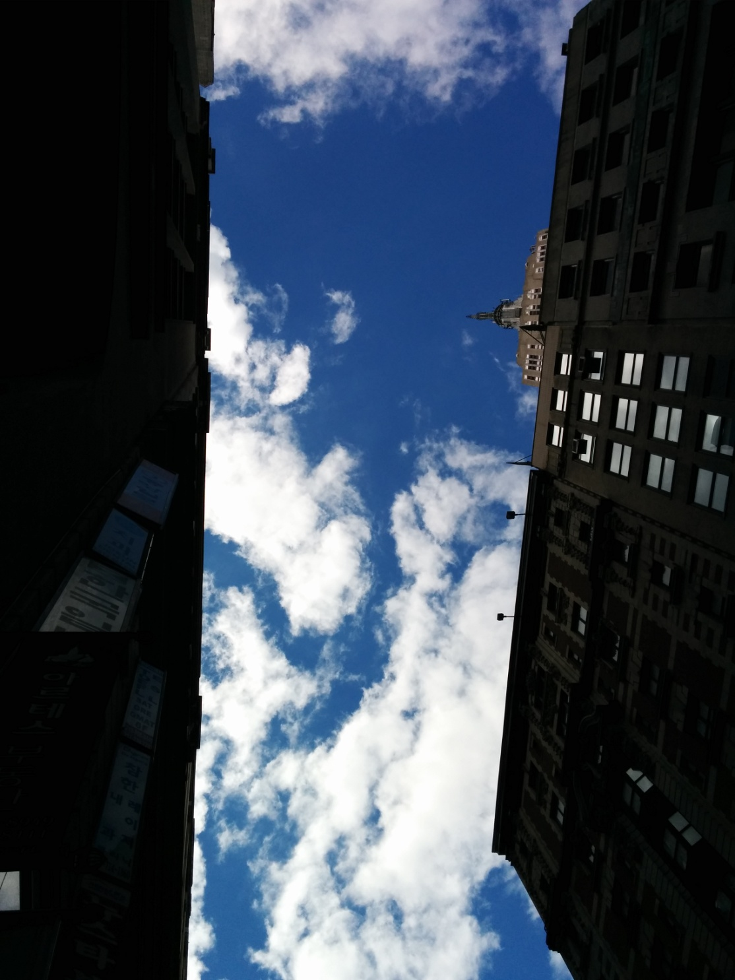
Photography assignment: Unusual Points of View
Connie Xinhui Wang

Slide 26
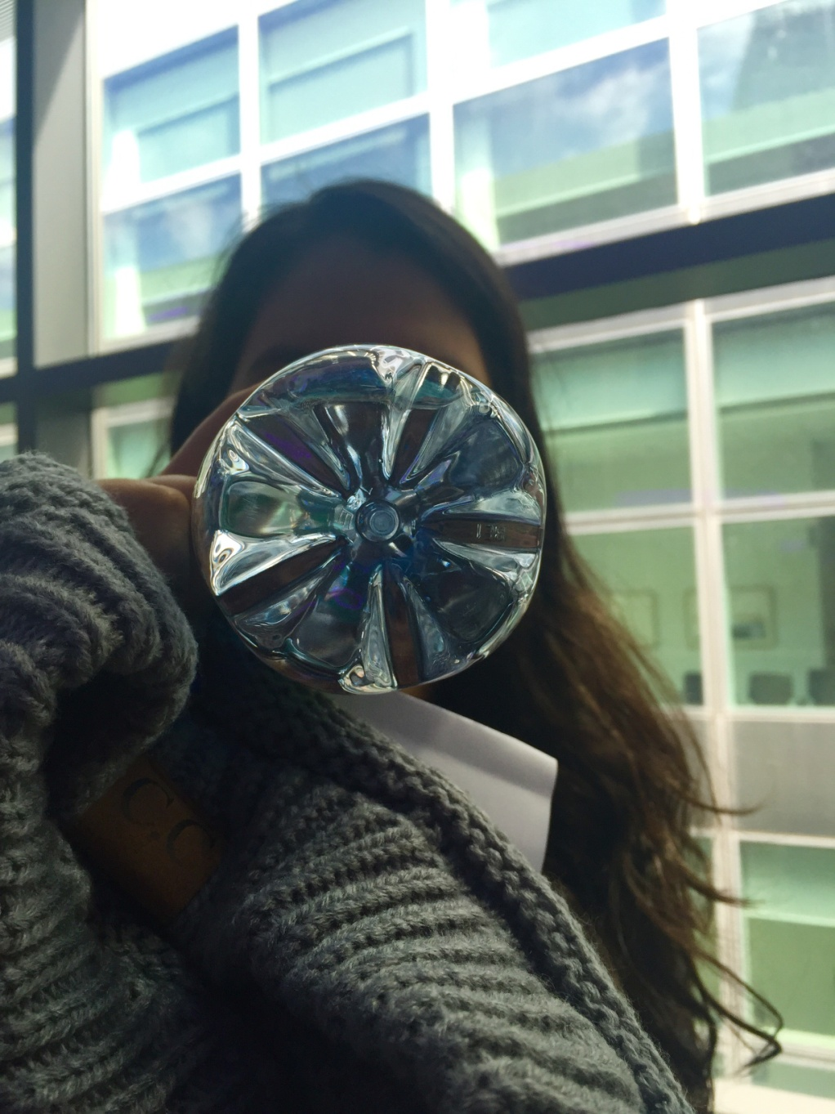
Unusual Points of View
Kerry-Ann Pinard

Slide 27
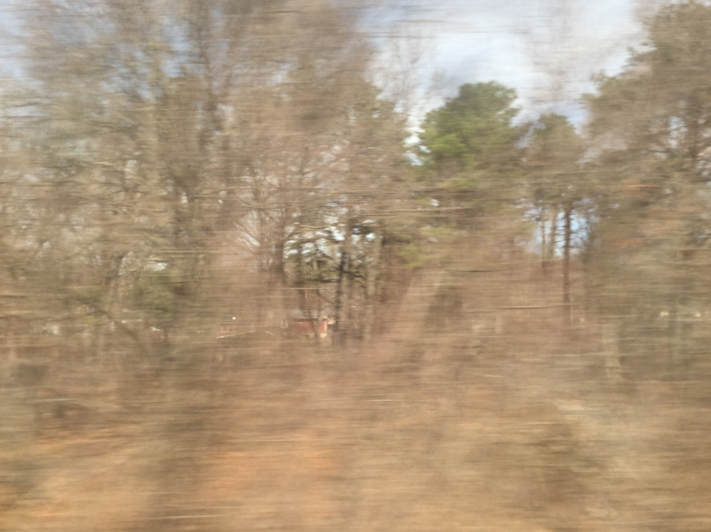
Unusual Points of View: Amtrak Expressionism
Eric Zheng

Slide 28
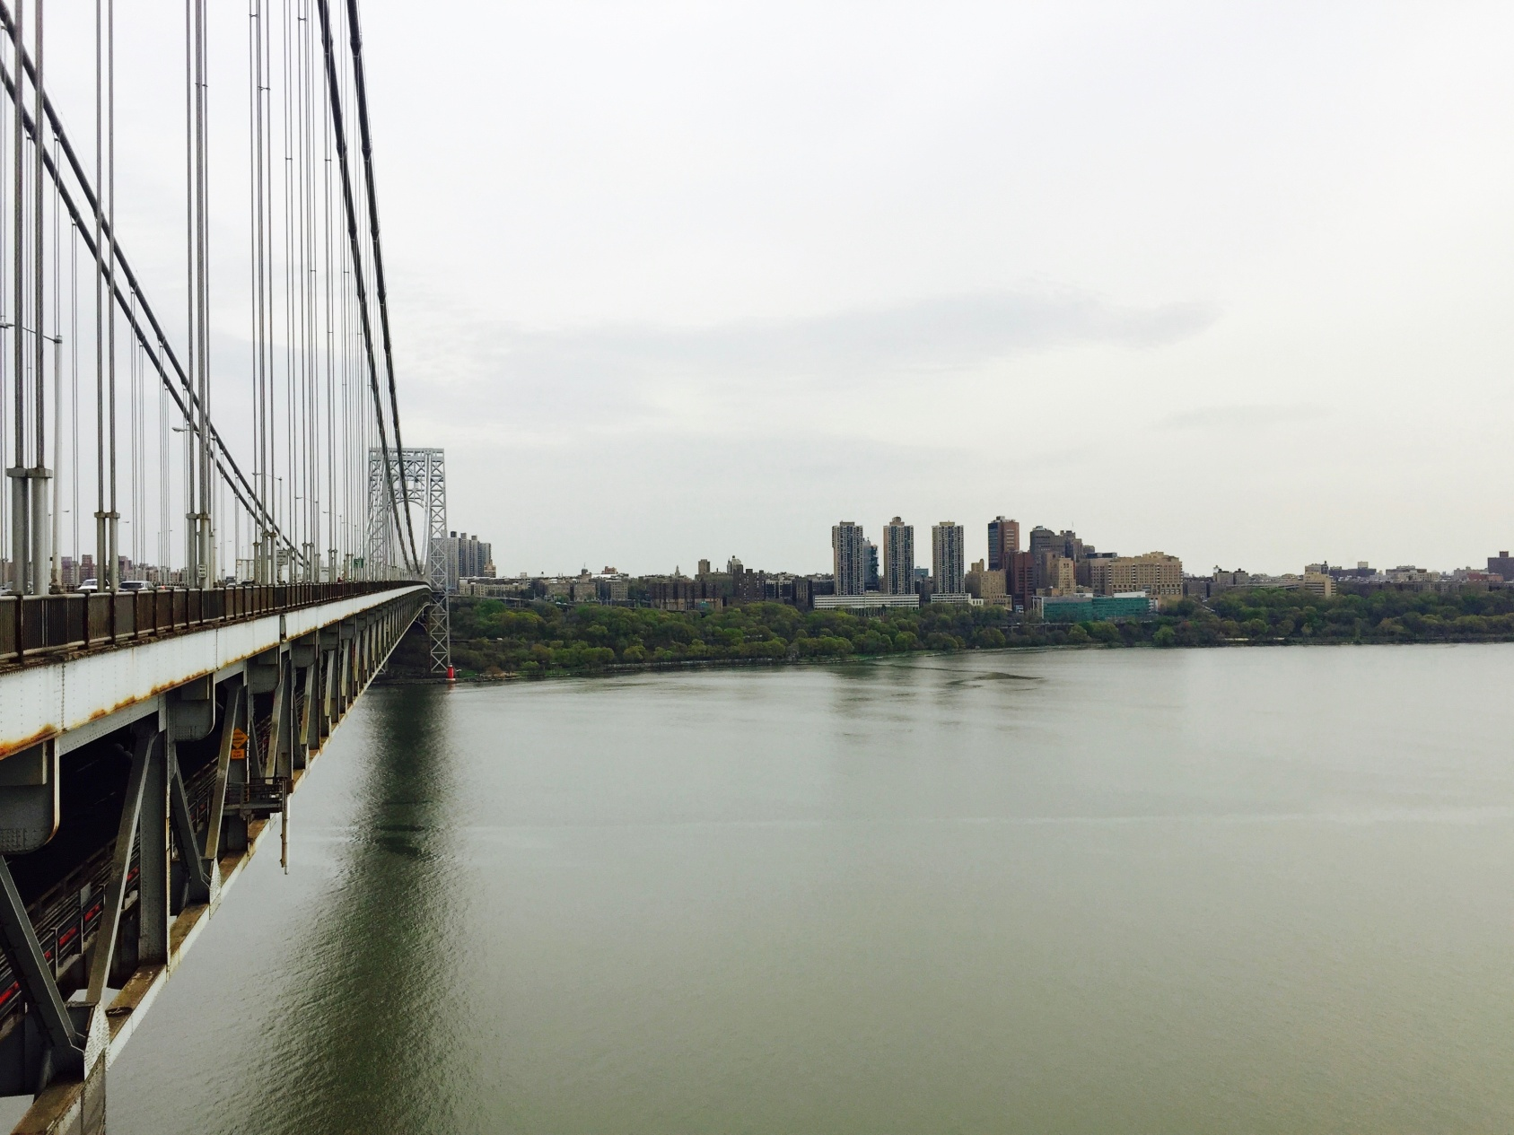
Unusual Points of View
Caroline Park

Slide 29
Future Directions
Design of art making courses for medical students
Integration of other art forms such as theater and dance
Investigation of multi-media art classes

